Slide 1
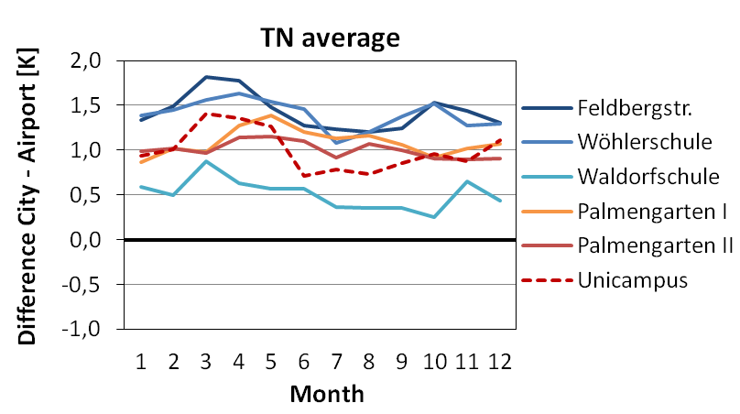
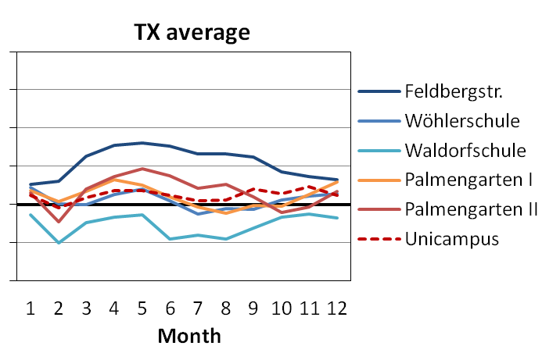
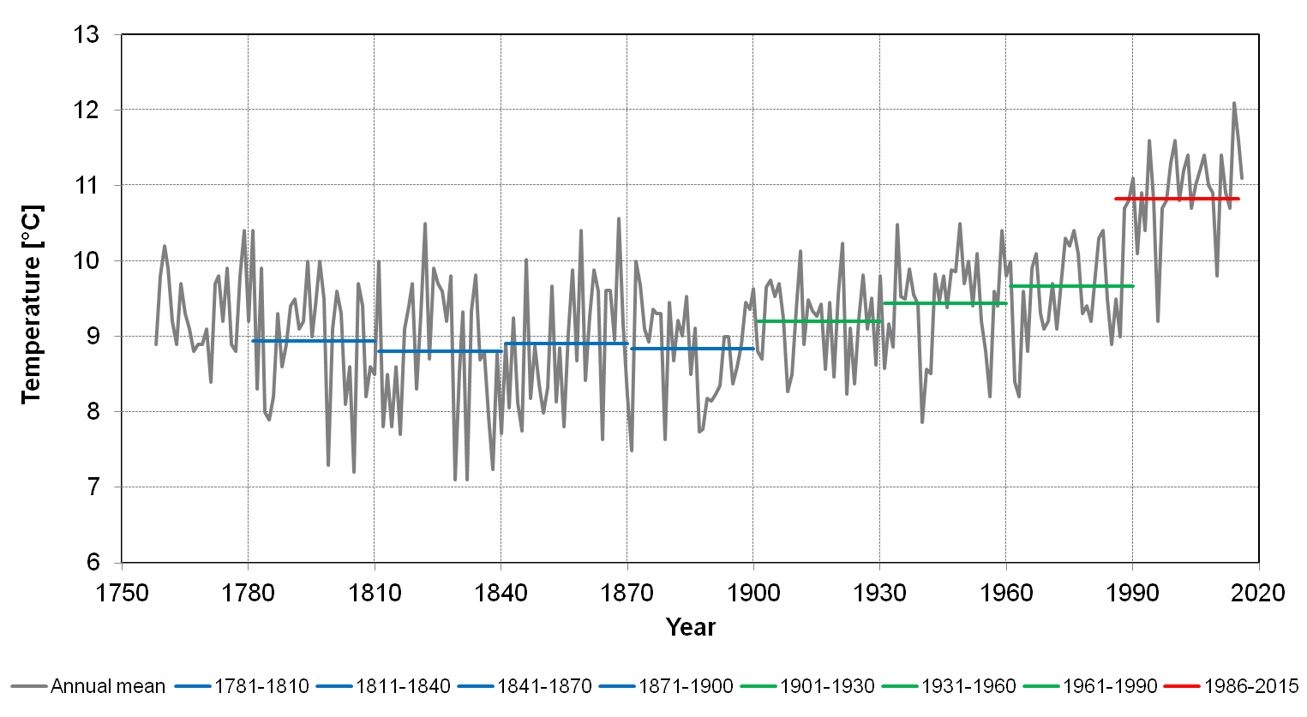
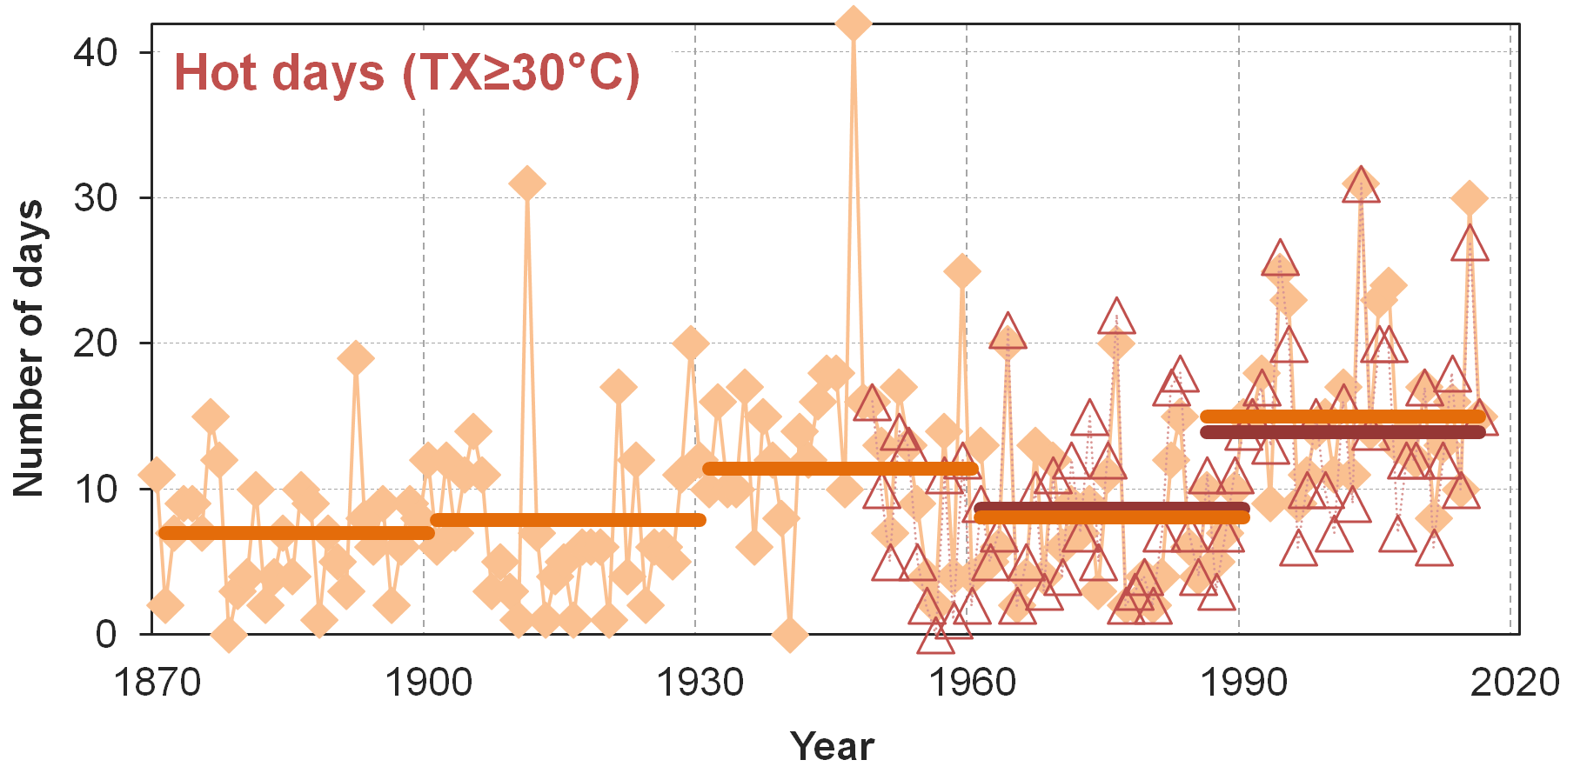
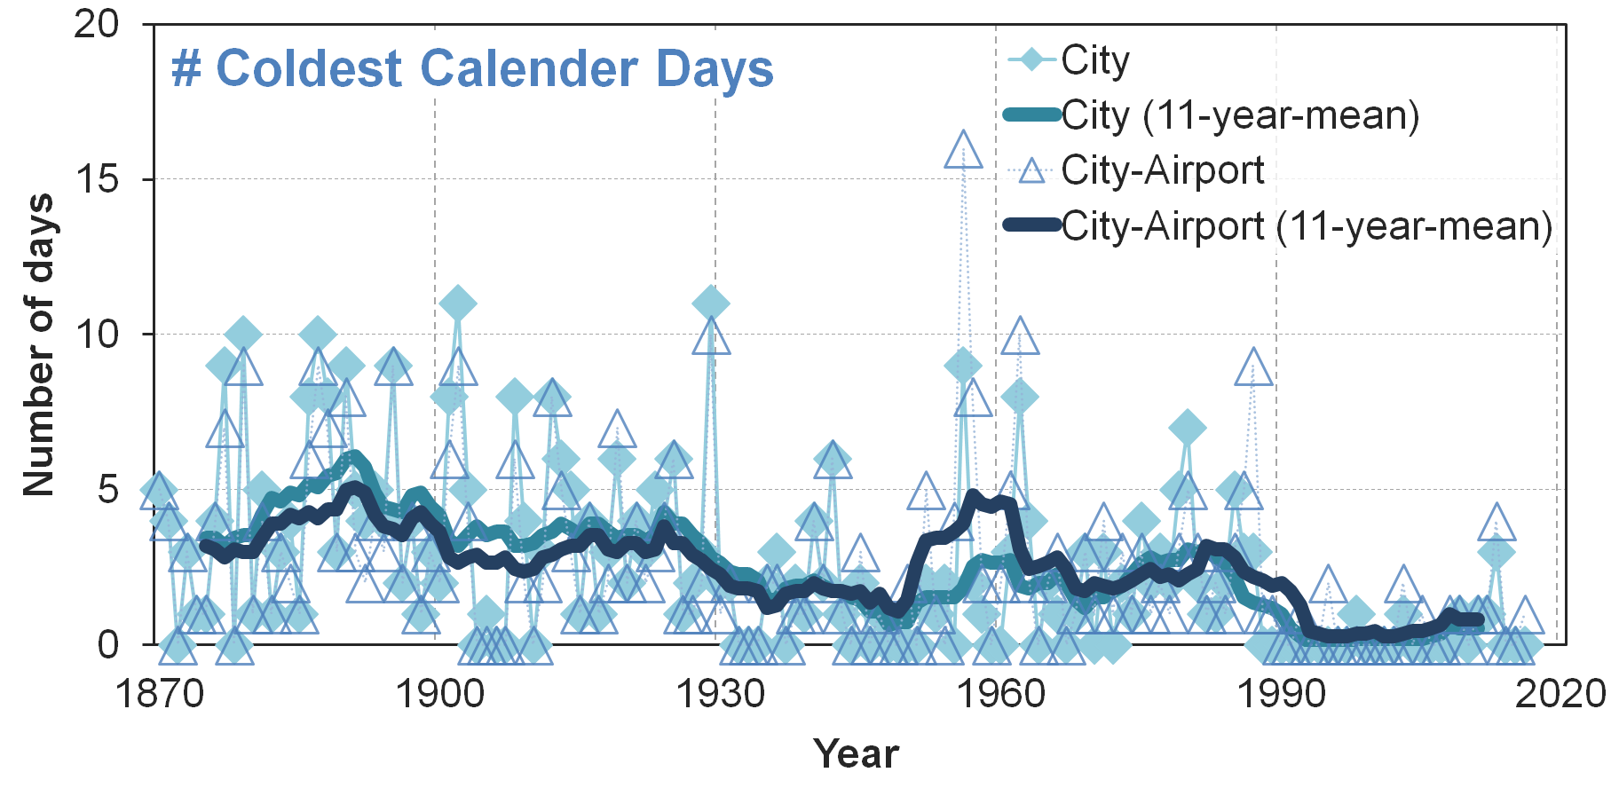
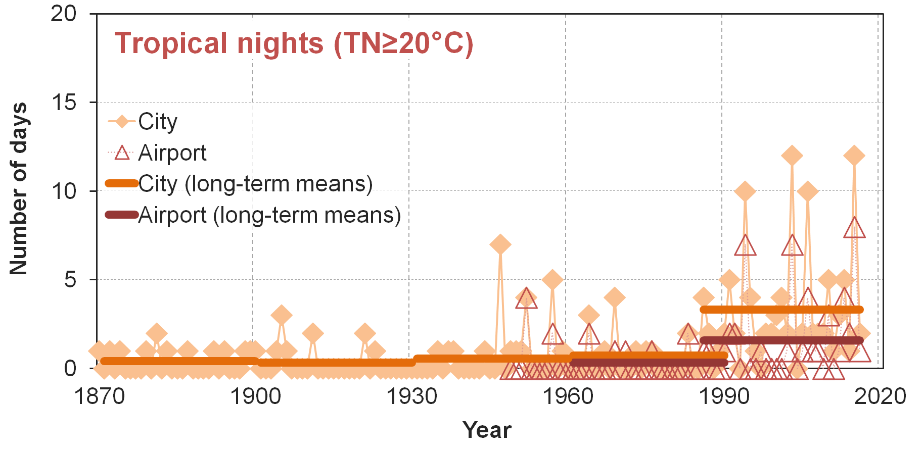
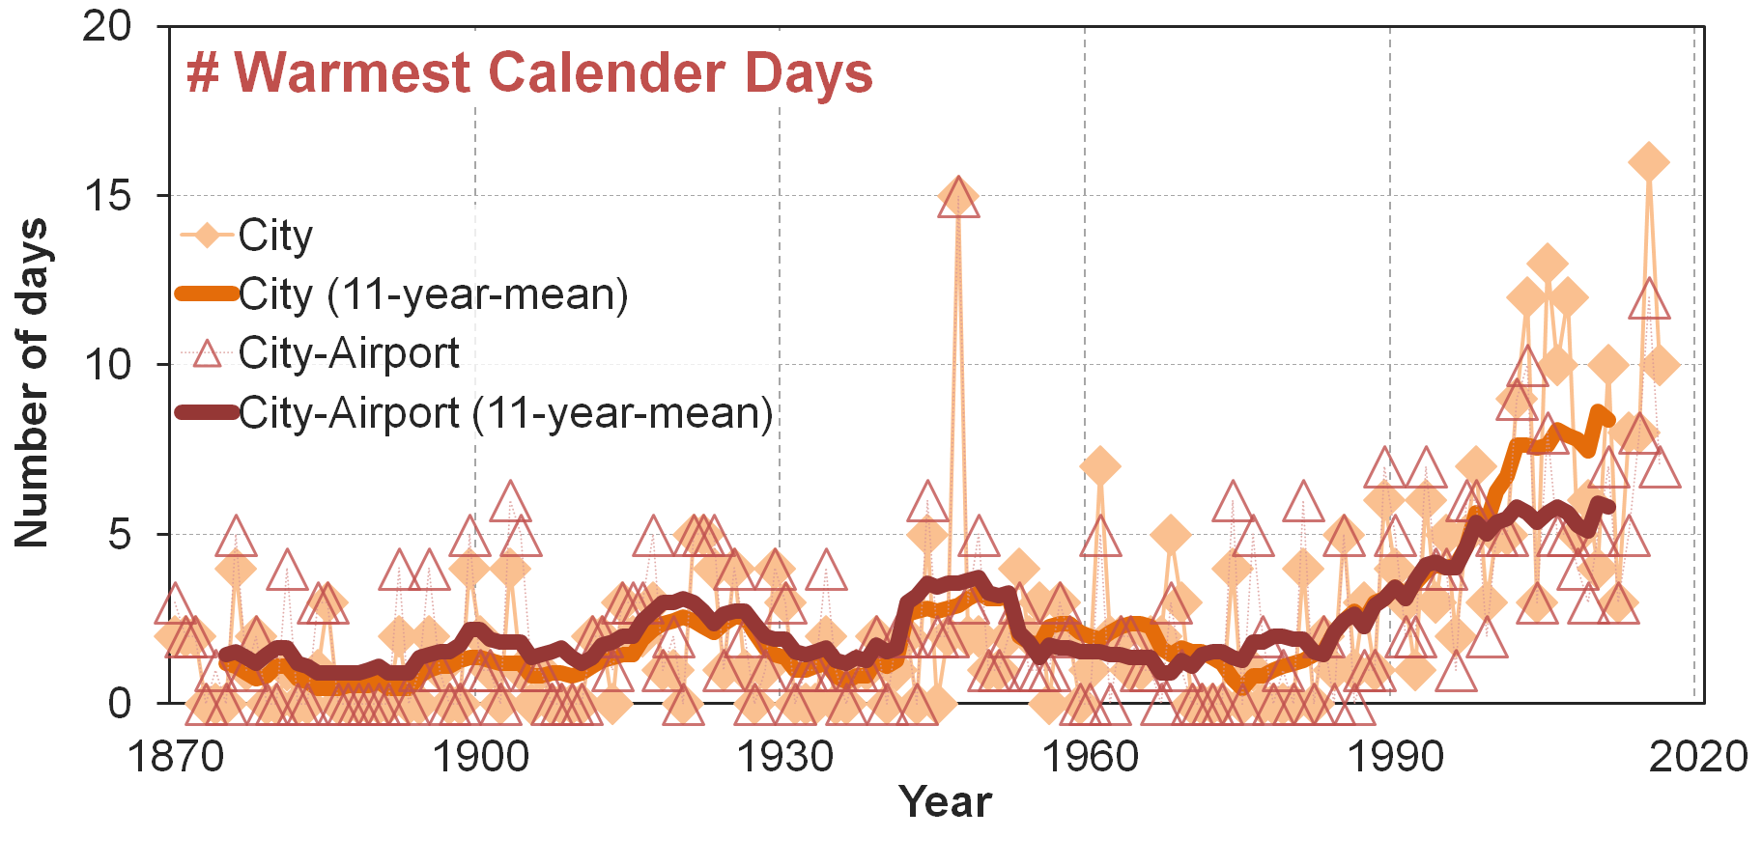
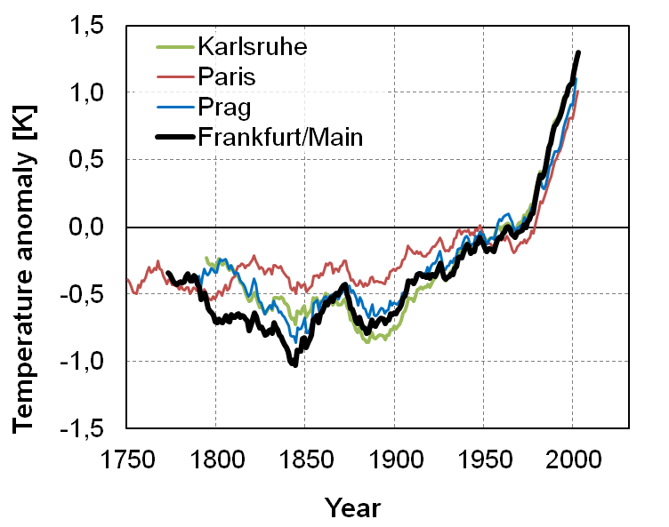
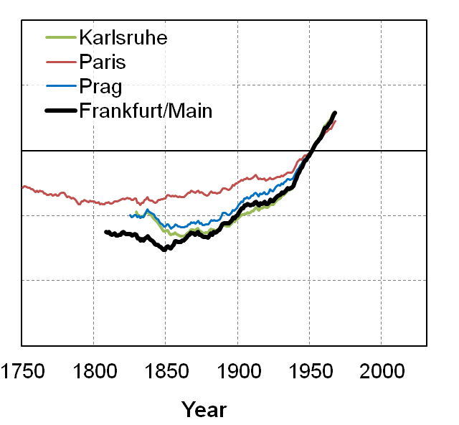
The exceptional recent warming signal in a long-term central-German observation site
Andreas Hoy^{1,2}, Christian-Dietrich Schönwiese²
Hessian Agency for Nature Conservation, Environment and Geology, Hessian Centre on Climate Change, Rheingaustr. 186, 65203 Wiesbaden, Germany
Goethe University, Institute for Atmosphere and Environment, P.O. Box 111932, 60054 Frankfurt a.M., Germany
1) Introduction
Long-term instrumental temperature measurements are important tools to investigate observed climate variations of past centuries. In Germany, only very few meteorological observations are accessible before the end of the 18th century. This contribution investigates homogenised annual temperature data of Frankfurt/Main (Central Germany) since 1758, as well as unprocessed daily data preserved since 1870, to detect change signals.
Table 1: Metadata of Frankfurt/Main city observations since 1949; based on Früh et al. (2011), the Climate data centre of Deutscher Wetterdienst (ftp://ftp-cdc.dwd.de/pub/CDC/ ) and own investigations
Location | Time frame | m. NN | Characteristics
Feldbergstraße | Until 11/1961 | 109 | Very high building density
Wöhlerschule | 12/1961–3/1973 | 125 | High building density
Waldorfschule | 4/1973–9/1984 | 125 | Low building density, shallow dip, nearby meadow
Palmengarten | 11/1985–7/2008 | 107 | Park area with greenhouses, nearby street
Westend | Since 8/2008 | 124 | Medium building density, small park area
2) Metadata and artificial effects
Comparison: two sites in Frankfurt/Main with urban (city) and rural (airport) characteristics
City site: data from 1758 (annual) / 1870 (daily); varying locations (table 1 from 1949)
Airport site: daily data since 1949; good reference for site changes and urbanisation effect of the respective city locations (altitude 112 m NN, no larger site change until 11/2014)
Annual temperature series: from 1949 airport data, before based on various city locations homogenised and recalculated to airport site; based on Brinckmann (2005) / Schönwiese (2015)
Site change effects: considerable for even small relocations (average annual deviation between coolest and warmest site 0.9 K for TN and TX; up to 1.3 K in certain months; fig.1)
Urbanisation effects: city warming (strongly) visible for TN (long-term annual average of 1.1K; up to 1.8 K in certain months), but low for TX (average of 0.1 K; between -0.5 and 0.8; fig.1)
Figure 1: Monthly averages of minimum (TN) and maximum (TX) temperature: difference of selected Frankfurt/Main city locations (see table 1) from Frankfurt/Main airport; location “Palmengarten” split into two periods of similar length for comparison purposes (I: 11/1985–1996; II: 1997–7/2008)
3) Annual temperature time series (1758–2016)
4) Daily temperature time series (1870–2016)
Site change effects: similar long-term developments between city and city/airport, but switch to airport leads to artificial enhancement of cold extremes in 1950s/1960s
Cold extremes: most frequent until the 1920s; suddenly disappear almost completely from 1988
Warm extremes: well-distributed until the 1980s with notable maximum in 1947; sudden rise from 1989 and again 2002 (only now strong urbanisation effect in the city)
Figure 2: Average annual air temperature for Frankfurt/Main airport site for 1758–2016 (homogenised; until 1948 based on city site); coloured lines: 30-year climate normals
Secular temperature variability (1): decadal-scale and yearly fluctuations dominate long-term trends until 20th century (fig. 2); very similar developments in nearby Karlsruhe and in Prague since ca. 1850 (Paris reflects more maritime climate), earlier times may still be impacted by remaining inhomogenities (fig. 3)
Secular temperature variability (2): only 1 K spread between coldest (1829–1858) and warmest 30-year-periods (1948–1977) up to the 1980s (fig. 2, 3)
Recent temperature level: 30-year-mean 1986–2015 was warmer than any single year before 1988 (10.82°C; earlier annual maximum: 10.6°C; fig. 2, 3)
Figure 5: Time series of hot days and tropical nights; evaluations for a) Frankfurt city site from 1870 and b) Frankfurt airport site from 1949; 30-year-means from 1871–1900, last 1986–2015
Hot days: natural decadal variability with warmer 1931– 1960 and colder 1961–1990 periods gets visible; recent 30-year-period warmest, but without new extremes (fig. 5)
Tropical nights: hardly relevant until the 1980s; strong increase from the end-1980s with (a few) tropical nights in most years now
Urbanisation effect: very similar results for hot days, but city site shows much stronger rise in tropical nights
30-year mean
100-year mean
Figure 4: Time series of cold and warm all-time extremes (daily mean temperature; one value per calendar day); evaluations for a) Frankfurt city site and b) combined Frankfurt city site until 1948 / Frankfurt airport site from 1949 onwards
5) Conclusions
Data validity: importance of studying metadata prior to climatological evaluations (location changes, urban effect)
Recent temperature rise: robust signal of sustained higher temperature level from 1988 → missing cold, but largely increasing # of warm extremes; enhanced in build-up areas
Figure 3: Comparison of long-term annual mean temperature anomalies from 20th century averages of a) Frankfurt/Main (from 1758; black line) with other homogenised time series: b) Karlsruhe (100 km southwards; from 1779; HISTALP project), c) Paris (westwards; 1659; Rousseau 2015), d) Prague (eastwards; 1775; Brazdil et al. 2012)
Literature: Brázdil, R., Bělínová, M., Dobrovolný, P., Mikšovský, J., Pišoft, P., Řezníčková, L., Štěpánek, P., Valášek, H., Zahradníček, P. (2012): History of Weather and Climate in the Czech Lands IX: Temperature and Precipitation Fluctuations in the Czech Lands during the Instrumental Period. Masarykova univerzita, Brno, 236 pp; Brinckmann, S. (2005): Anwendung der schrittweisen Regression auf Temperatur-Zeitreihen zur Separierung anthropogener und natürlicher Einflüsse. Diploma thesis. Univ. Frankfurt a. M., 116 pp; Früh, B., Koßmann, M., Roos, M. (2011): Frankfurt am Main im Klimawandel – Eine Untersuchung zur städtischen Wärmebelastung. Ber. Dt. Wetterdienst 237. Offenbach a. M., 68 pp; HISTALP project (2017): http://www.zamg.ac.at/histalp/index.php; Rousseau, D. (2015): Variabilité des températures mensuelles à Paris de 1658 à 2014. XXVIIIe Colloque de l’Association Internationale de Climatologie. Liège; Schönwiese, C.D. (2015): Die Temperaturreihe Frankfurt a. M. 1758–2014. Mitteilungen DMG 02/2015, p. 8.

