Slide 1
International Dispute Settlement
Dr Mateja Steinbrück Platise, M. Jur (Oxford)
Max Planck Institute for Comparative Public Law
and International Law
Phone: 06221 482 349
platise@mpil.de

Slide 2
Structure of the Course
Basic Concepts
Methods of Dispute Settlement
Fields and Institutions
Selected Trends and Challenges
Exam

Slide 3
Literature
John G. Merrills, International Dispute Settlement, Cambridge University Press, 2022, 261-347, 383-438.
Yoshifumi Tanaka, The Peaceful Settlement of International Disputes, Cambridge University Press, 2018, 227-352.
John Collier and Vaughan Lowe, The Settlement of Disputes in International Law, Institutions and Procedures, Oxford University Press, 1999, 59-123.

Slide 4
3. Fields and Institutions
3.1. The United Nations
3.2. The Dispute Settlement under the Law of the Sea Convention
3.3. International Trade and Investment Dispute Settlement
3.4. Human Rights Litigation
3.5. International Criminal Courts and Tribunals
3.6. Environmental Protection

Slide 5
3.2. The Dispute Settlement under the Law of the Sea Convention
The 1982 United Nations Convention on the Law of the Sea (UNCLOS):
“A Constitution for the Oceans;” regulates activities of very diverse actors: states, international organizations, corporations, individuals
→ inter-state disputes + disputes with non-state actors
→ very broad variety of dispute settlement methods

Slide 6
3.2. The Dispute Settlement under the Law of the Sea Convention
Part XV on the UNCLOS (Settlement of Disputes)
Section 2 (compulsory procedures entailing binding decisions):
International Tribunal of the Law of the Sea (ITLOS)
International Court of Justice (ICJ)
Annex VII arbitral tribunal
Annex VIII special arbitral tribunal
→ If states choose none, or different procedures: Annex VII arbitration

Slide 7
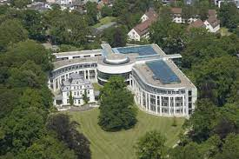
3.2. The Dispute Settlement under the Law of the Sea Convention
International Tribunal of the Law of the Sea (ITLOS)
Composition: 21 judges, 9-year term,
representing the principal legal systems
ad hoc judges
Chambers, including the Sea-Bed Dispute Chamber (hearing cases filed by states, mining companies, Sea-Bed Authority…)
! Enforcement of decisions of the Sea-Bed Chambers

Slide 8
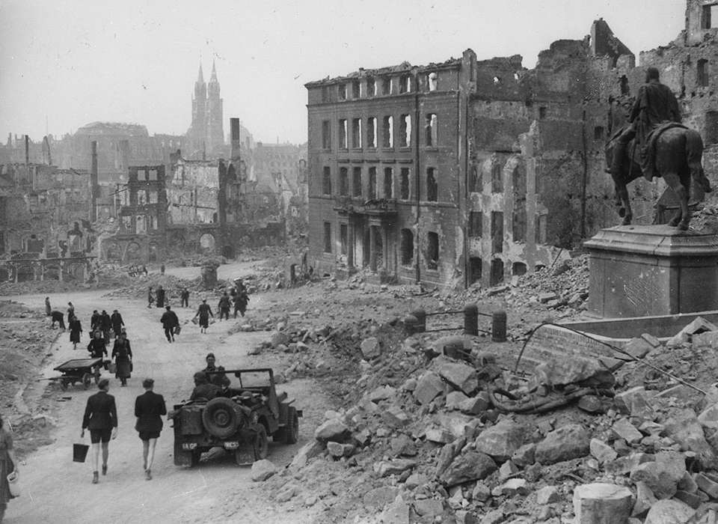
3.3. International Trade and Investment Dispute Settlement
The UN Charter, Chapter IX: International Economic and Social Cooperation, Article 55:
With a view to the creation of conditions of stability and well-being which are necessary for peaceful and friendly relations among nations based on respect for the principle of equal rights and self-determination of peoples, the United Nations shall promote:
a. higher standards of living, full employment, and conditions of economic and social progress and development;…

Slide 9
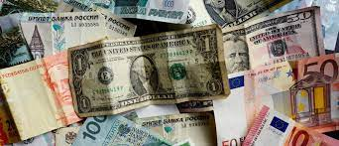
3.3. International Trade and Investment Dispute Settlement
International economic order on the global level:
The World Trade Organization (WTO)
The World Bank
The International Monetary Fund (IMF)

Slide 10
3.3. International Trade and Investment Dispute Settlement
World Trade Organisation (WTO)
non-discrimination and the Most Favored Nation treatment = basis of international trade order
Main interests protected: economic development and profit
Dispute settlement based on the analysis, whether benefits that states expected to gain have been impaired or nullified, rather than whether their rights have been breached

Slide 11
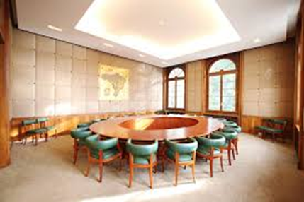
3.3. International Trade and Investment Dispute Settlement
Annex to the WTO Agreement:
The Dispute Settlement Understanding (DSU)
Basic dispute settlement methods: notification and consultation, good offices, mediation and conciliation by the WTO Director General
If unsuccessful, recourse to a panel established by the WTO Dispute Settlement Body (usually 3 members)

Slide 12
3.3. International Trade and Investment Dispute Settlement
WTO Dispute Settlement Body
= representatives of all member states
adopts panels’ reports with recommendations → become binding
If the panel’s report appealed: adopts reports by the Appellate Body
monitors the implementation of the panels’ recommendations
authorizes the suspension of concessions and other WTO obligations towards the respondent state

Slide 13
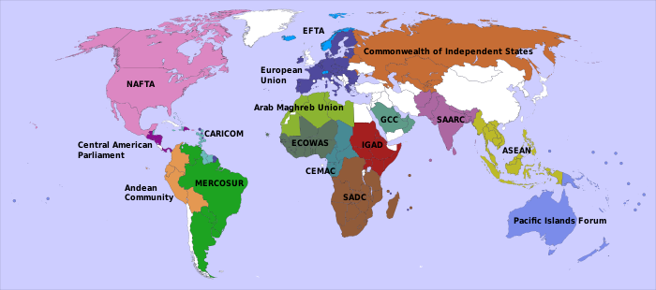
3.3. International Trade and Investment Dispute Settlement
International economic order on the regional level, e.g.:
The European Union (EU; originally European Coal and Steel Community, European Atomic Energy Community and European Economic Community)
The North American Free Trade Agreement (NAFTA)
The Common Market for Eastern and Southern Africa (COMESA)
The Common Community of West African States (ECOWAS) …

Slide 14
3.3. International Trade and Investment Dispute Settlement
The International Centre for the Settlement of Investment Disputes (ICSID; World Bank)
Balancing interests between foreign investors and their host countries
Idea: Dispute settlement mechanism detached from national law of the hosting state and the investor state
The 1966 Washington Convention on the Settlement of Investment Disputes between States and Nationals of Others States (the ICSID Convention)

Slide 15
3.3. International Trade and Investment Dispute Settlement
Article 25 of the ICSID Convention:
(1) The jurisdiction of the Centre shall extend to any legal dispute arising directly out of an investment, between a Contracting State … and a national of another Contracting State, which the parties to the dispute consent in writing to submit to the Centre. ...
1978 ICSID Additional Facility extended the jurisdiction:
only one of the states needs to be a contracting state
dispute not arising directly out of the investment
fact-finding

Slide 16
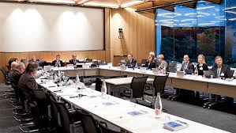
3.3. International Trade and Investment Dispute Settlement
ICSID: Mixed arbitration
jurisdiction ratione materie: rules of law as agreed by the parties / the law of the contracting state party to the dispute and international law
Arbitral award: final and binding, enforceable in the country as if it was a national court’s judgment

Slide 17
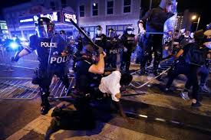
3.4. Human Rights Litigation
Interests protected: human individual and his dignity; universality of human rights
Idea: exact reconstruction of the breach of an obligation owed by the state toward an individual
Vulnerability of the individual; very high public interest
→ some dispute settlement methods less appropriate

Slide 18
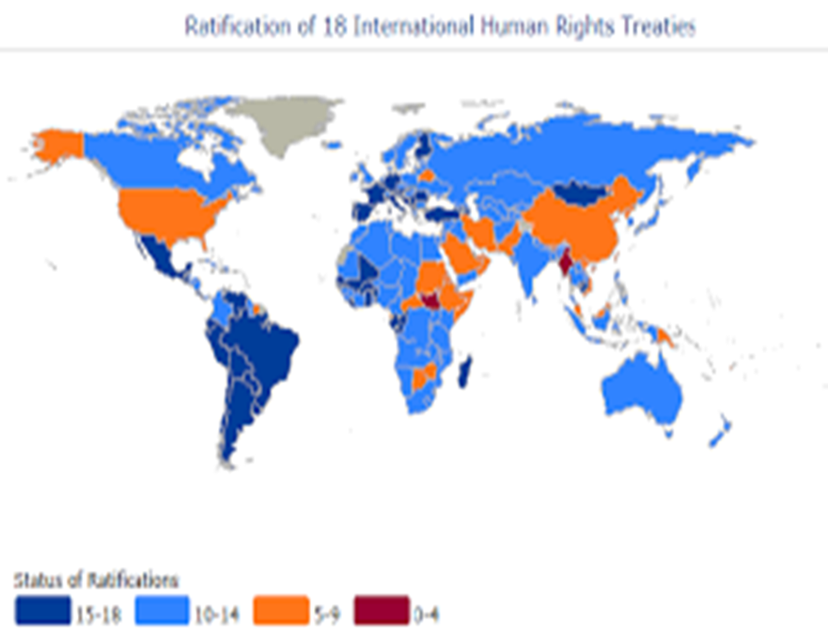
3.4. Human Rights Litigation
Universal scope:
UN Charter (Arts 1(3) and 55); 9 core human rights treaties adopted within the UN, incl. the 1966 International Covenant on Civil and Political Rights
at best complaint procedure
(e.g. Human Rights Council; UN Human
Rights Committee)
Fact-finding missions (see 3.1. The UN)

Slide 19
3.4. Human Rights Litigation
Regional scope:
adjudication → more effective, compulsory
The European Union (EU)
The Council of Europe (CoE)
The Organisation of American States (OAS)
The African Union (AU)

Slide 20
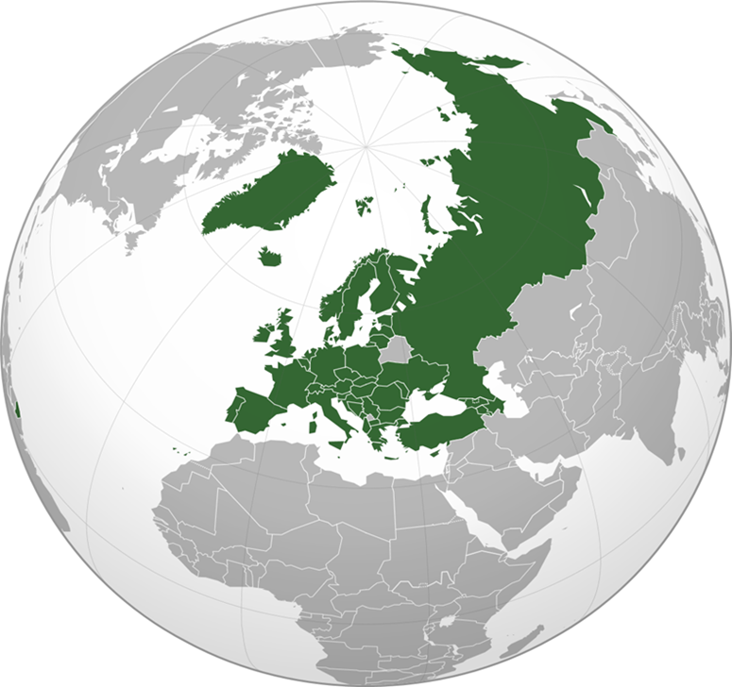
3.4. Human Rights Litigation
The Council of Europe (CoE)
The European Convention for the Protection of Human Rights and Fundamental Freedoms (1950) → European Court of Human Rights
The European Social Charter (1961) → European Committee of Social Rights
+ Other human rights treaties, with monitoring bodies

Slide 21
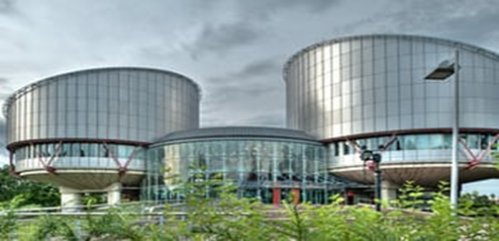
3.4. Human Rights Litigation
The European Court of Human Rights
47-1 judges, 9-year mandate
Contentious and advisory jurisdiction
Jurisdiction ratione materie: The Convention and other rules of IL
Jurisdiction ratione personae:
Passive standing: states parties
Active standing: Any state party;
individuals, NGO’s
Judgments are final and binding, implementation supervised by the Council of Ministers

Slide 22
3.5. International Criminal Courts and Tribunals
To prosecute individuals for
the international crimes of genocide,
crimes against humanity, and war crimes
International Criminal Tribunal for the Former Yugoslavia (ICTY)
International Criminal Tribunal for Rwanda (ICTR)
= ad hoc tribunals, created by resolutions of the UN SC
International Criminal Court (ICC)
= established by the treaty, the Rome Statute of the ICC

Slide 23
3.6. Environmental Protection
No single body specialized for
settlement of int. environmental disputes
Non-compliance procedures
provided for in different environmental treaties
Diplomatic means; fact-finding commissions; judicial bodies: ICJ, ECHR, ITLOS, WTO panels
UN Guiding Principles on Business and Human Rights; The OECD Guidelines for Multinational Enterprises

Slide 24
4. Selected Trends and Challenges
Structural Bias
Competing Forums
Implementation
Informal Governance

Slide 25
Thank you…
…and have a nice weekend!

